Slide 1
Bond pricing II
BKM Chapter 15-16

Slide 2
Last time and this time
Last Time: Introduction to bond pricing
What is a bond?
Various types of bonds
How to price a bond.
The YTM
What is it?
How to solve for it.
Risk, ratings, and the probability of default (on your own).
This time:
Lab 2
The term structure of interest rates under certainty
The term structure under uncertainty

Slide 3
Textbook Problems to help with bond pricing for exam
Practice
Ch 15 1-5, 14, CFA 1,2,5,7,8
Ch 16 1,2,4,8 CFA 3

Slide 4
Lab 2
Q4 part e solution (similar to solution on lab 2)
You have examined ten mutual funds and found that the top mutual fund in your sample outperformed its benchmark by 0.3% per month. The standard deviation of the outperformance is 2% per month. This low number is achieved because the benchmark is fairly highly correlated with your portfolio.

Slide 5
Part e
Suppose that the true level of outperformance is actually 0.2% per month for a particular mutual fund with a standard deviation of 2%. Using the critical t-value from part c (2.915) and the number of observations you found in part d (377), what is the probability that you will find that this manager’s average return statistically significantly beat the benchmark?

Slide 6
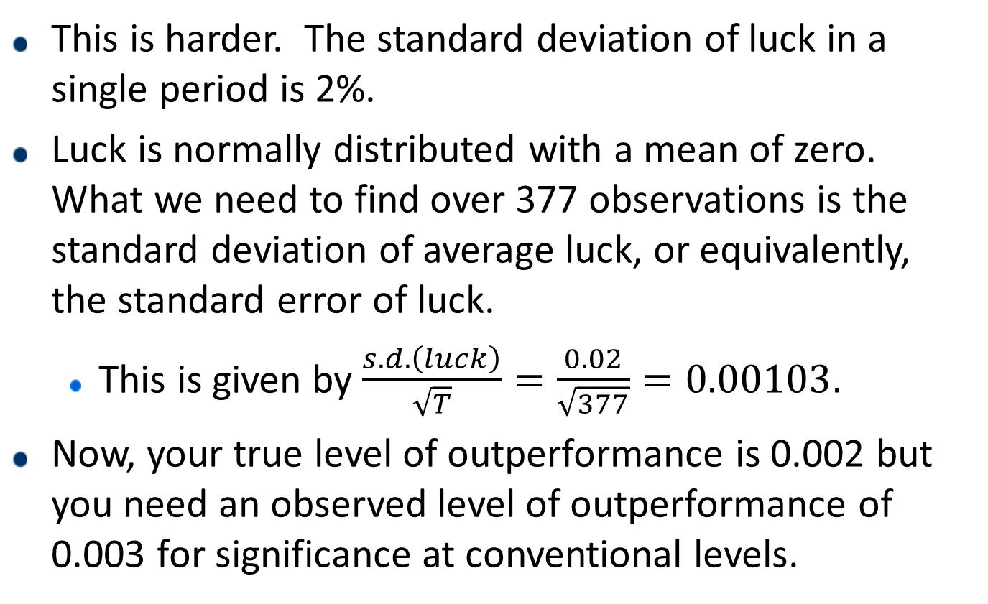
Part e
This is harder. The standard deviation of luck in a single period is 2%.
Luck is normally distributed with a mean of zero. What we need to find over 377 observations is the standard deviation of average luck, or equivalently, the standard error of luck.
This is given by $\frac{s.d. \left(luck\right)}{\sqrt{T}}=\frac{0.02}{\sqrt{377}}=0.00103.$
Now, your true level of outperformance is 0.002 but you need an observed level of outperformance of 0.003 for significance at conventional levels.

Slide 7
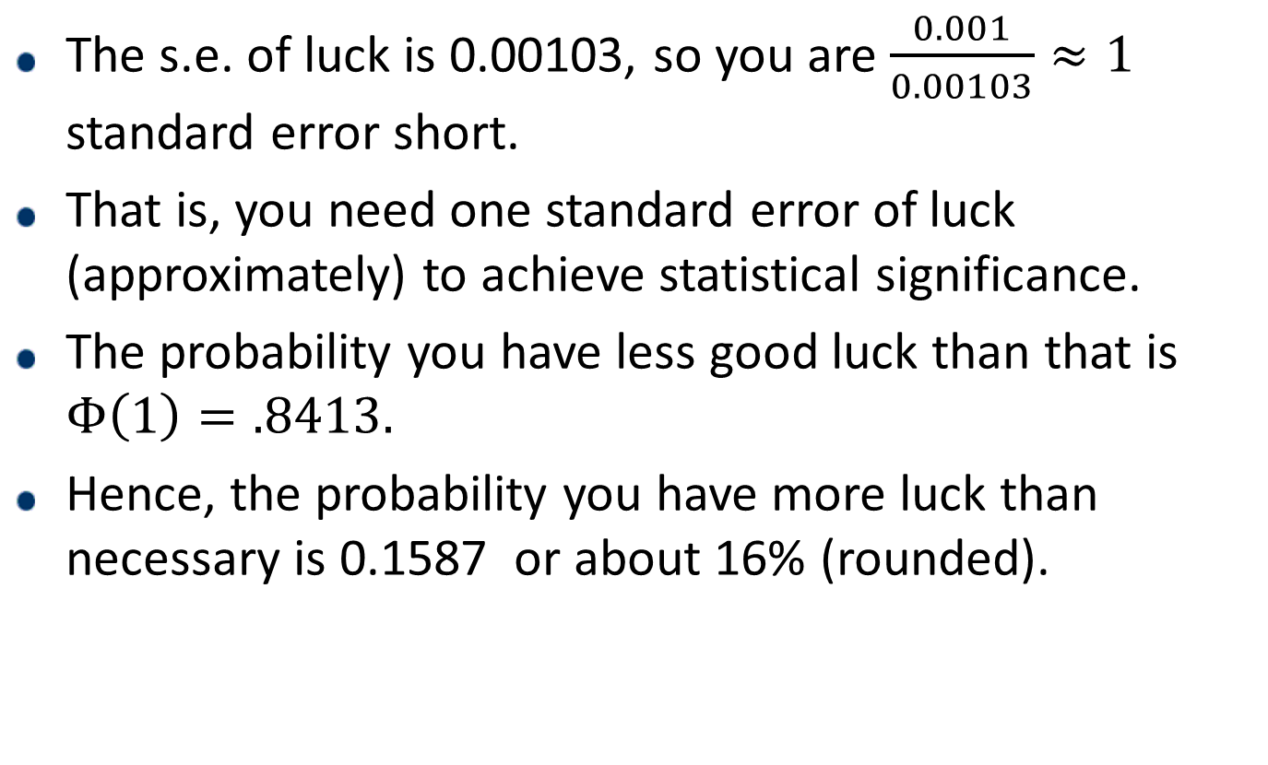
Part e
The s.e. of luck is 0.00103, so you are $\frac{0.001}{0.00103}≈1$ standard error short.
That is, you need one standard error of luck (approximately) to achieve statistical significance.
The probability you have less good luck than that is $Φ\left(1\right)=.8413.$
Hence, the probability you have more luck than necessary is 0.1587 or about 16% (rounded).

Slide 8
1. The Term Structure of Interest Rates
Definition: a relationship between yield to maturity and maturity.
The yield curve is a graph that displays this relationship.
The question we will eventually address is “Why is the yield curve shaped the way it is?”
We will do the following:

Slide 9
1. The term structure: what we will cover
First:
Define the term structure
Spot rates of interest
Forward rates of interest
We will then
Investigate the relation between spot and forward rates
Under certainty,
Under uncertainty.

Slide 10
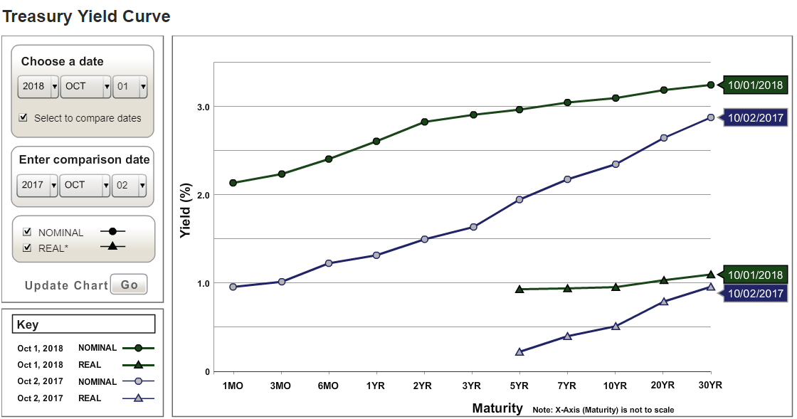
1. Treasury Yield Curve 10-1-18 and 10-2-17

Slide 11
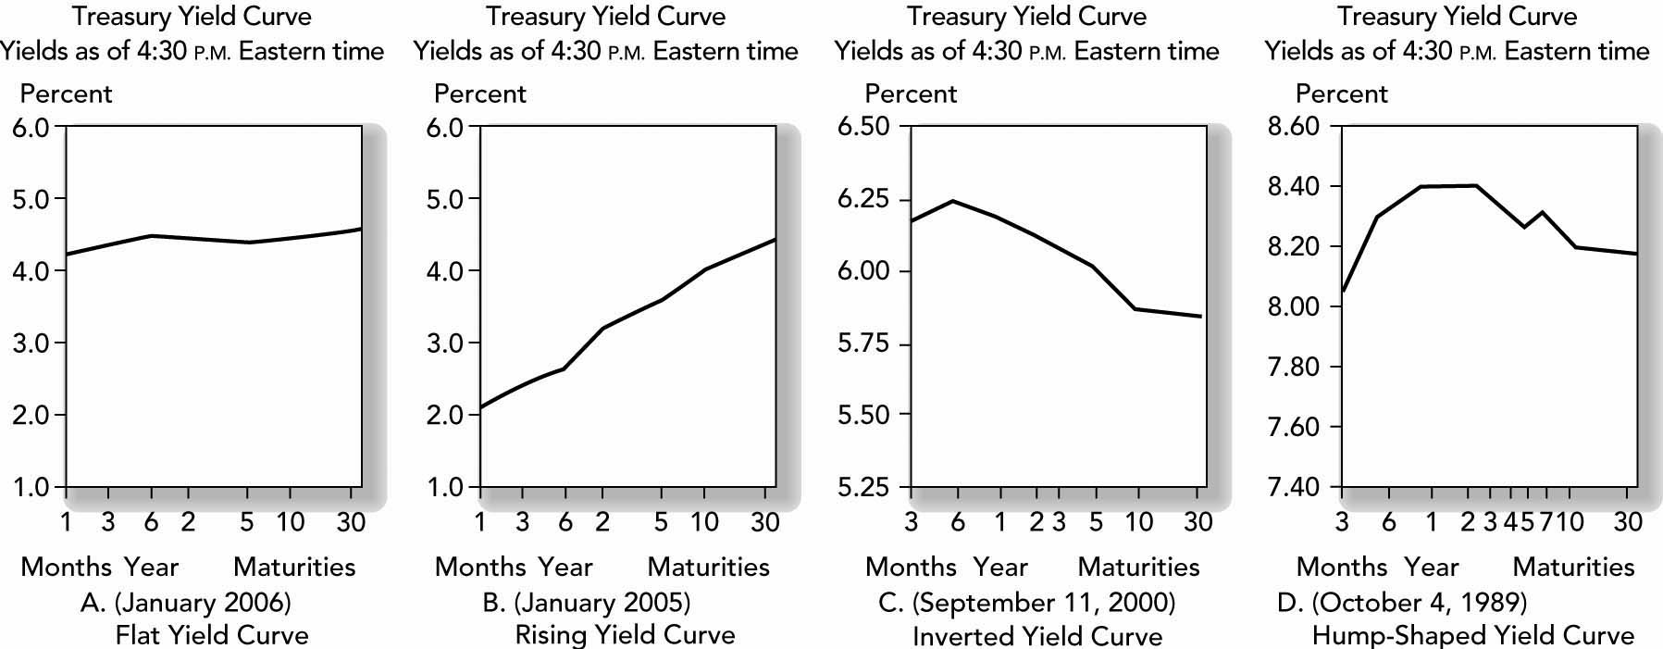
Yield Curve on other earlier dates (BKM)
Notice that yields are not the same for different treasury bonds.
Yet long rates are not always higher.
If you have different interest rates for different maturities, what do you use for a discount factor? Hint: using the treasury yield for riskless bonds is probably wrong.

Slide 12
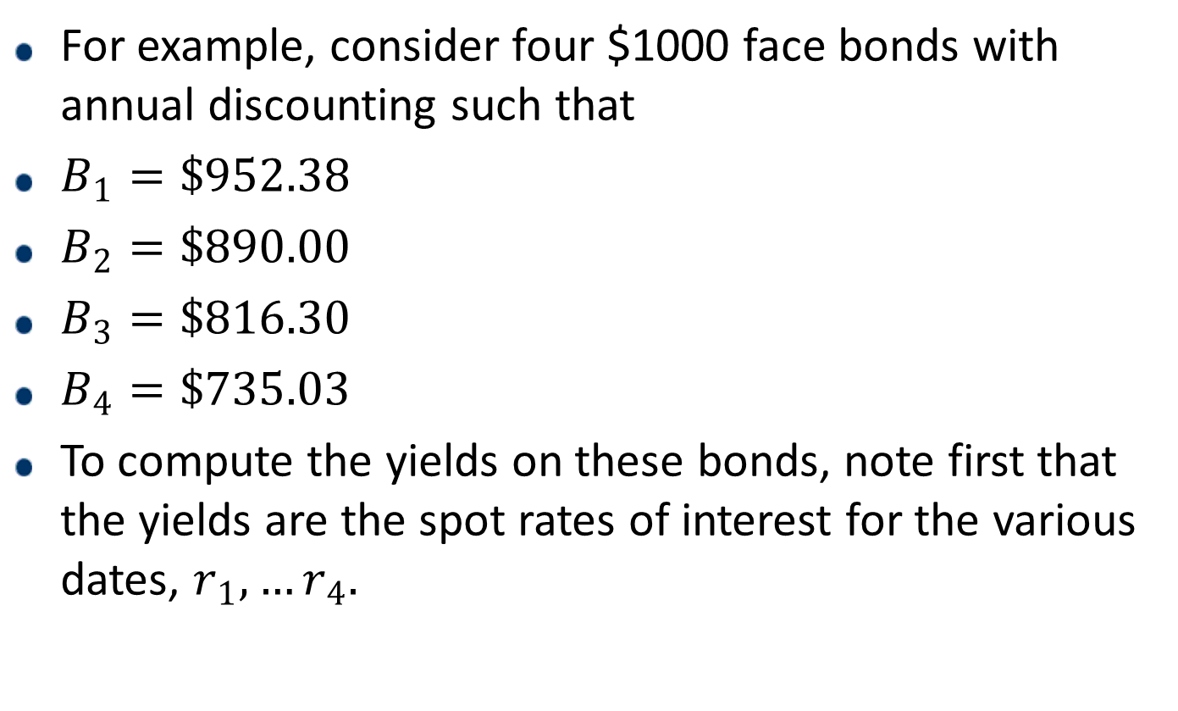
1. For example: YTM and Prices on Zero-Coupon Bonds ($1,000 Face) This is the yield curve defined in terms of spot rates
For example, consider four $1000 face bonds with annual discounting such that
$B_{1}=\$952.38$
$B_{2}=\$890.00$
$B_{3}=\$816.30$
$B_{4}=\$735.03$
To compute the yields on these bonds, note first that the yields are the spot rates of interest for the various dates, $r_{1},…r_{4}.$

Slide 13
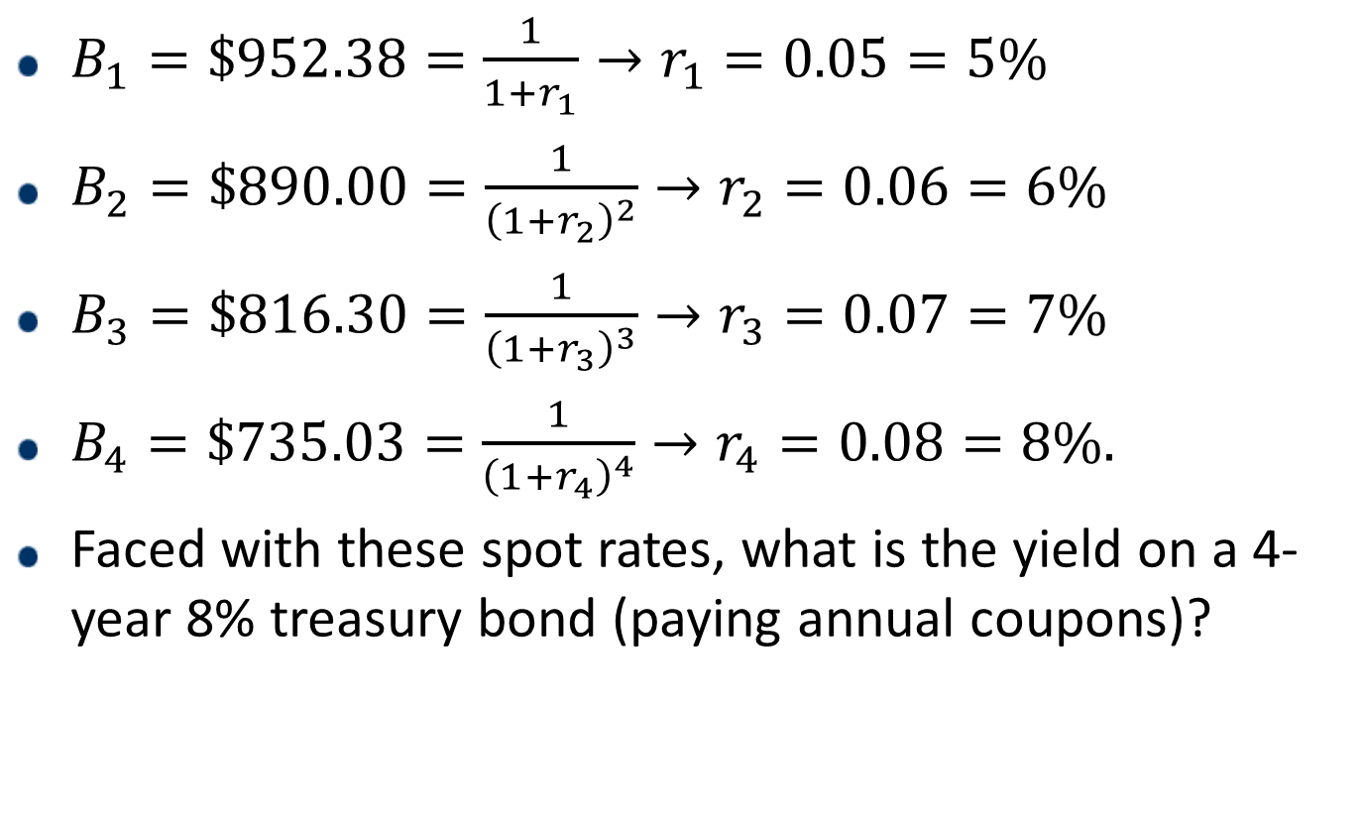
1. For example: YTM and Prices on Zero-Coupon Bonds ($1,000 Face) This is the yield curve defined in terms of spot rates
$B_{1}=\$952.38=\frac{1}{1+r_{1}}→r_{1}=0.05=5\%$
$B_{2}=\$890.00=\frac{1}{{\left(1+r_{2}\right)}^{2}}→r_{2}=0.06=6\%$
$B_{3}=\$816.30=\frac{1}{{\left(1+r_{3}\right)}^{3}}→r_{3}=0.07=7\%$
$B_{4}=\$735.03=\frac{1}{{\left(1+r_{4}\right)}^{4}}→r_{4}=0.08=8\%.$
Faced with these spot rates, what is the yield on a 4-year 8% treasury bond (paying annual coupons)?

Slide 14
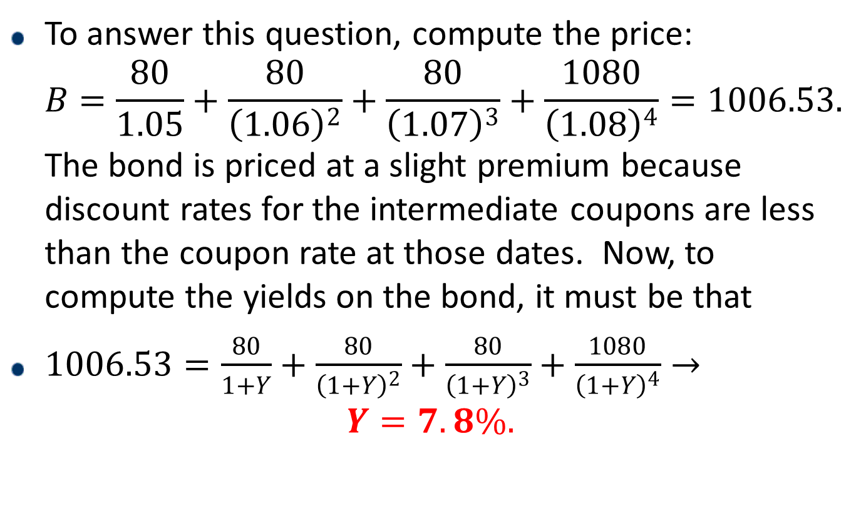
1. YTM on a coupon bond using the spot rates computed previously
To answer this question, compute the price: $B=\frac{80}{1.05}+\frac{80}{{\left(1.06\right)}^{2}}+\frac{80}{{\left(1.07\right)}^{3}}+\frac{1080}{{\left(1.08\right)}^{4}}=1006.53.$ The bond is priced at a slight premium because discount rates for the intermediate coupons are less than the coupon rate at those dates. Now, to compute the yields on the bond, it must be that
$1006.53=\frac{80}{1+Y}+\frac{80}{{\left(1+Y\right)}^{2}}+\frac{80}{{\left(1+Y\right)}^{3}}+\frac{1080}{{\left(1+Y\right)}^{4}}→$
$$Y=7.8\%.$$

Slide 15
1. The term structure: forward rates
Describing the term structure in terms of the spot rate yield curve (as we have done) is a complete description of the term structure.
But there is also information about borrowing and lending rates for any period in the future.
This is captured by the forward rate.

Slide 16
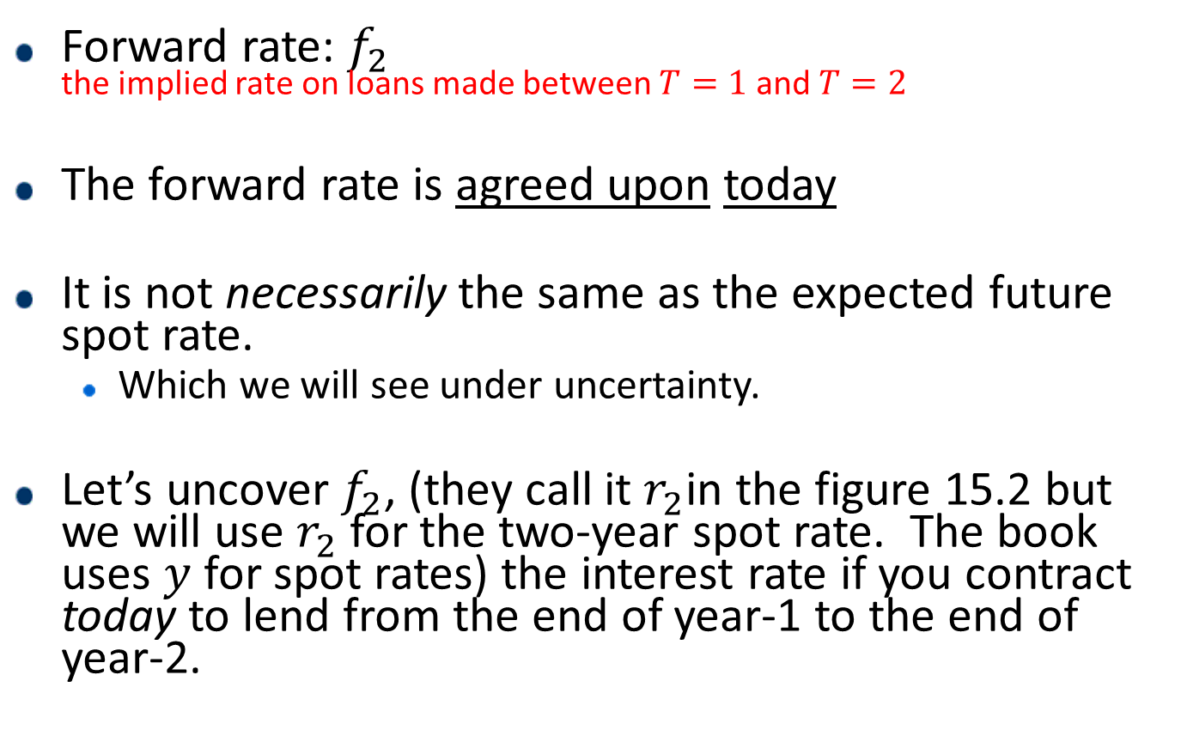
1. What’s a forward rate?
Forward rate: $f_{2}$ the implied rate on loans made between $T=1$ and $T=2$
The forward rate is agreed upon today
It is not necessarily the same as the expected future spot rate.
Which we will see under uncertainty.
Let’s uncover $f_{2}$, (they call it $r_{2}$in the figure 15.2 but we will use $r_{2}$ for the two-year spot rate. The book uses $y$ for spot rates) the interest rate if you contract today to lend from the end of year-1 to the end of year-2.

Slide 17
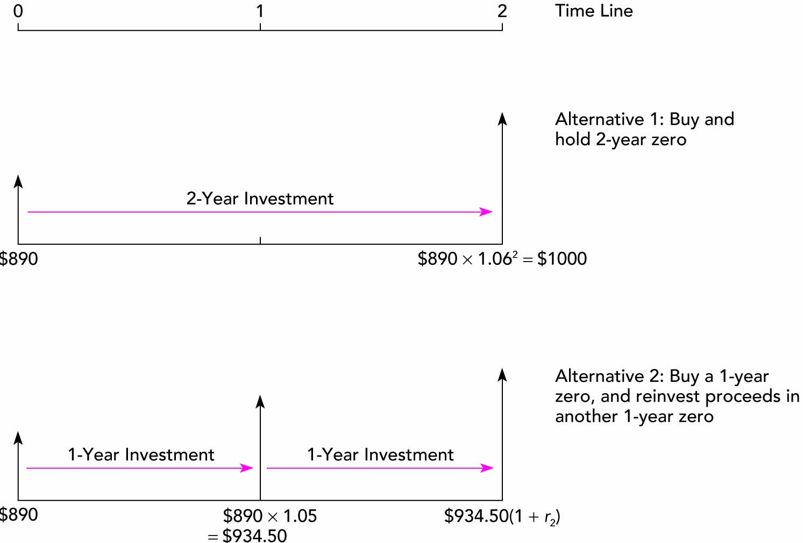
1. Two 2-Year Investment Programs

Slide 18
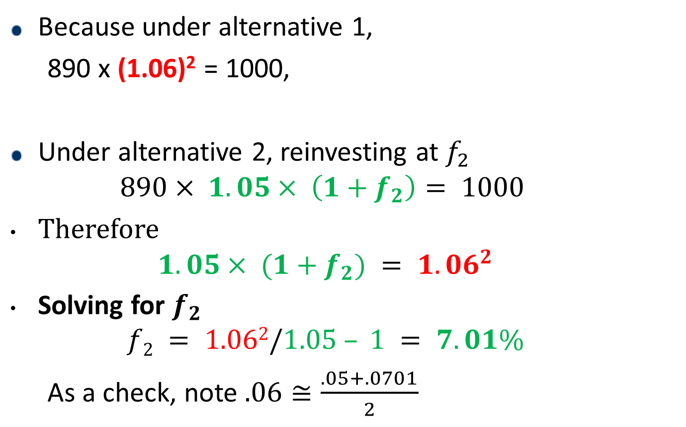
1. The forward rate is agreed upon today.
Because under alternative 1,
890 x (1.06)² = 1000,
Under alternative 2, reinvesting at $f_{2}$
$$890× 1.05× \left(1+f_{2}\right)= 1000$$
Therefore
$$1.05× (1+f_{2}) = 1.06^{2}$$
Solving for $f_{2}$
$$f2 = 1.062/1.05 – 1 = 7.01\%$$
As a check, note $.06≅\frac{.05+.0701}{2}$

Slide 19
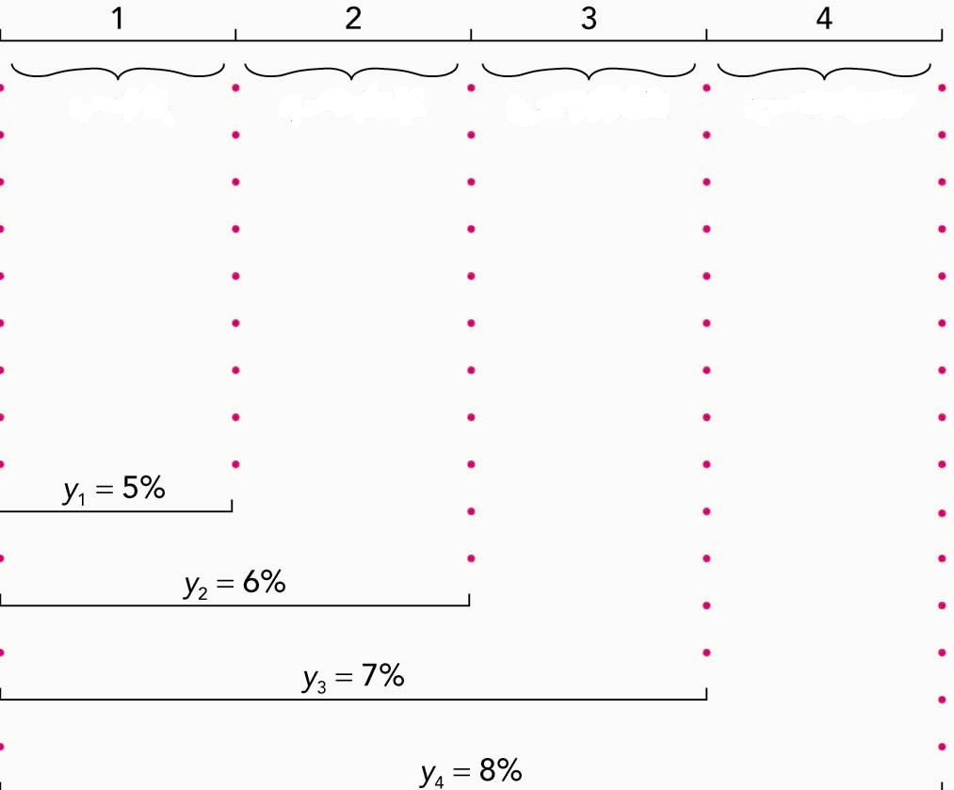
1. Finding the other forward rates

Slide 20
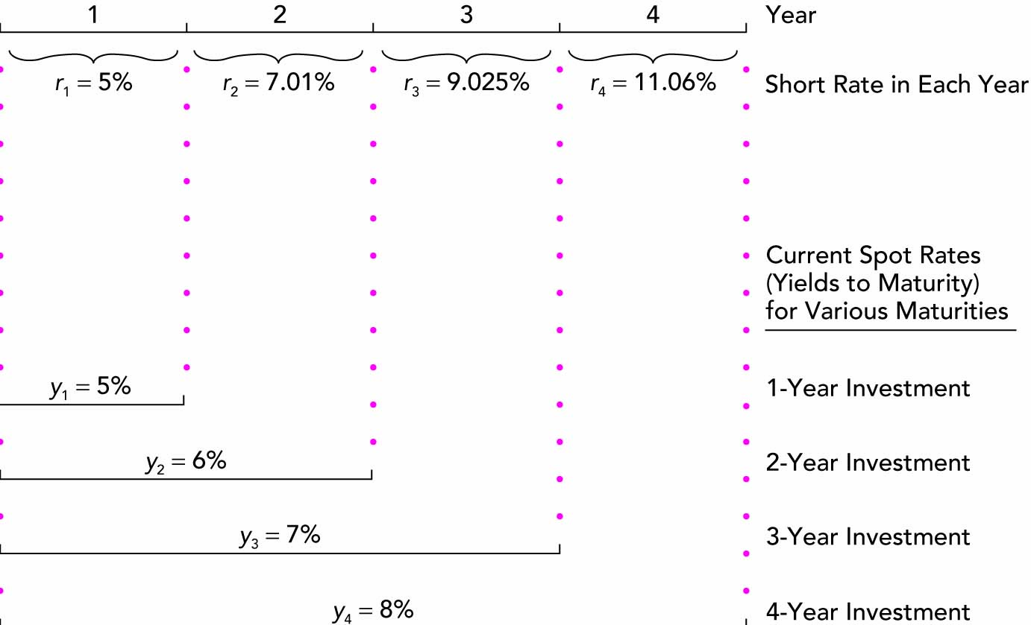
1. What we did: unwinding the term structure using zeroes

Slide 21
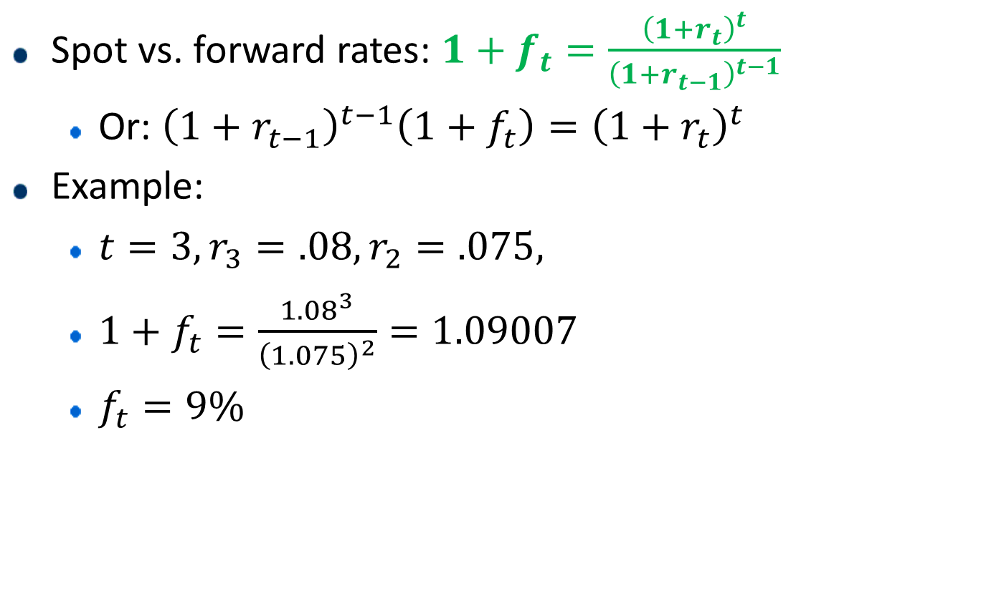
1. A formula relating forward and spot rates
Spot vs. forward rates: $1+f_{t}=\frac{{\left(1+r_{t}\right)}^{t}}{{\left(1+r_{t−1}\right)}^{t−1}}$
Or: ${\left(1+r_{t−1}\right)}^{t−1}\left(1+f_{t}\right)={\left(1+r_{t}\right)}^{t}$
Example:
$t=3, r_{3}=.08, r_{2}=.075,$
$1+f_{t}=\frac{{1.08}^{3}}{{\left(1.075\right)}^{2}}=1.09007$
$f_{t}=9\%$

Slide 22
1. Example – unwinding the term structure from coupon bonds
Here, assume all of the bonds pay annual interest, and some pay coupons
The reason for the different coupons and prices is that these bonds were issued at different times.
For example:

Slide 23
1. Bond prices and promised payoffs
Bond | Price/date | Year 1 | Year 2 | Year 3
A | 100 | 8 | 8 | 108
B | 95 | 6 | 106 | 0
C | 90 | 4 | 4 | 104

Slide 24
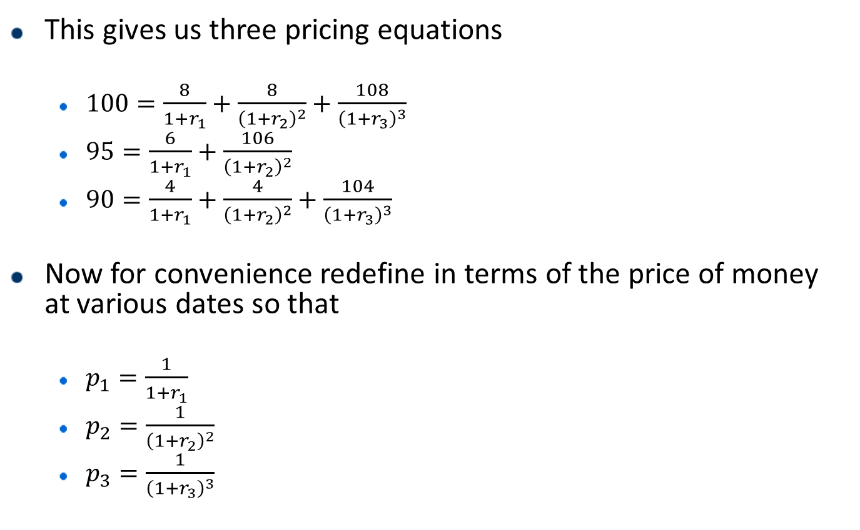
1. The solution
This gives us three pricing equations
$100=\frac{8}{1+r_{1}}+\frac{8}{{\left(1+r_{2}\right)}^{2}}+\frac{108}{{\left(1+r_{3}\right)}^{3}}$
$95=\frac{6}{1+r_{1}}+\frac{106}{{\left(1+r_{2}\right)}^{2}}$
$90=\frac{4}{1+r_{1}}+\frac{4}{{\left(1+r_{2}\right)}^{2}}+\frac{104}{{\left(1+r_{3}\right)}^{3}}$
Now for convenience redefine in terms of the price of money at various dates so that
$p_{1}=\frac{1}{1+r_{1}}$
$p_{2}=\frac{1}{{\left(1+r_{2}\right)}^{2}}$
$p_{3}=\frac{1}{{\left(1+r_{3}\right)}^{3}}$

Slide 25
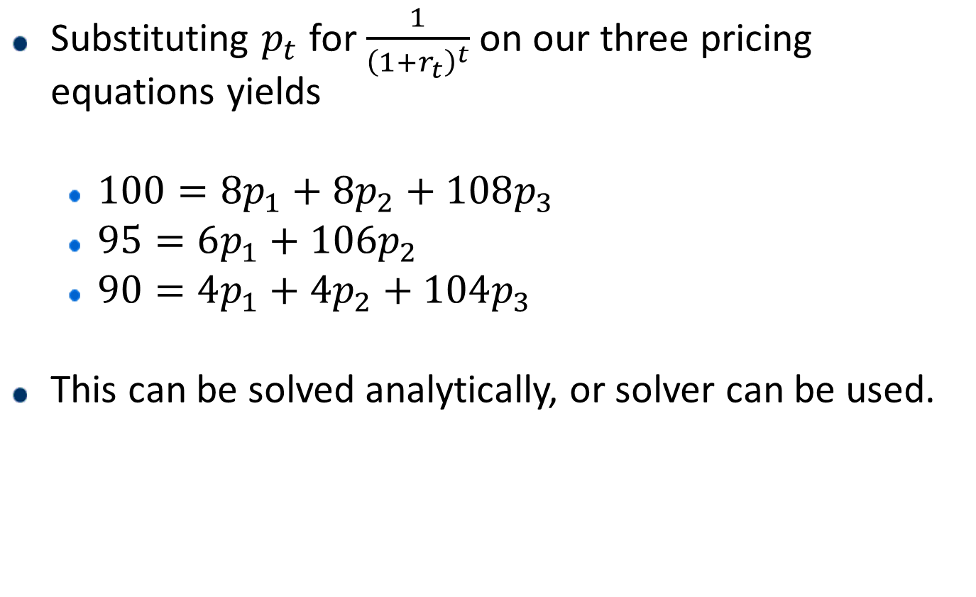
1. The solution
Substituting $p_{t}$ for $\frac{1}{{\left(1+r_{t}\right)}^{t}}$ on our three pricing equations yields
$100=8p_{1}+8p_{2}+108p_{3}$
$95=6p_{1}+106p_{2}$
$90=4p_{1}+4p_{2}+104p_{3}$
This can be solved analytically, or solver can be used.

Slide 26
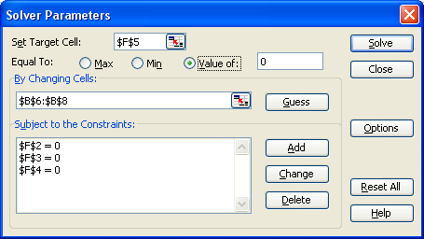
1. Using solver to solve systems of simultaneous equations
Set up the simultaneous equations as in the spreadsheet
Pick prices of money (p₁, p₂, p₃) to solve the three pricing equations. In solver:

Slide 27
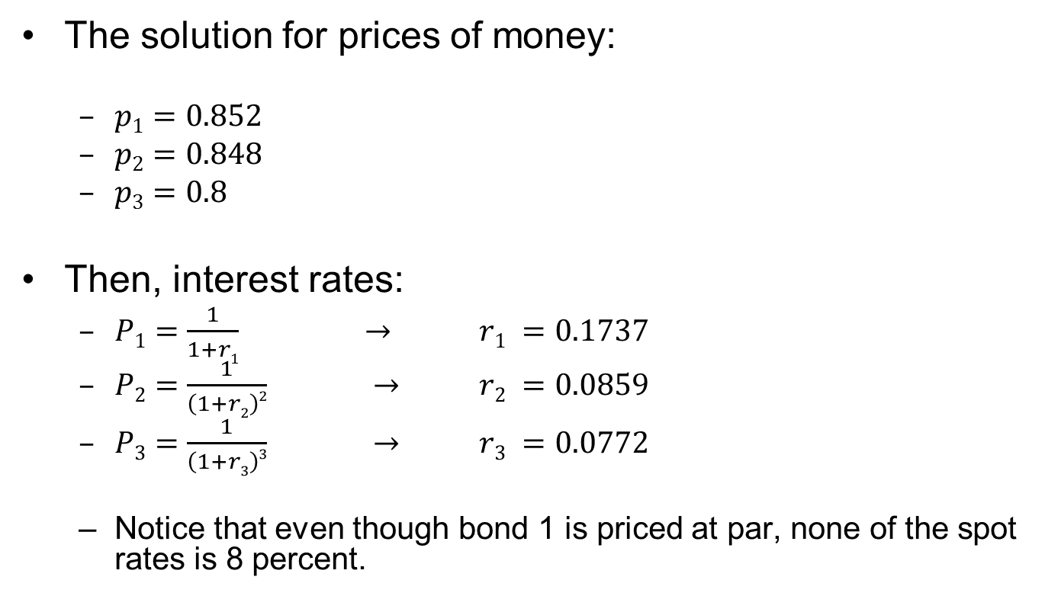
1. The solution
The solution for prices of money:
$p1=0.852$
$p2=0.848$
$p3=0.8$
Then, interest rates:
$P1=\frac{1}{1+r1}$ $→$ $r1 =0.1737$
$P2=\frac{1}{\left(1+r2\right)2}$ $→$ $r2 =0.0859$
$P3=\frac{1}{\left(1+r3\right)3}$ $→$ $r3 =0.0772$
Notice that even though bond 1 is priced at par, none of the spot rates is 8 percent.

Slide 28

1. The forward rates:
${\left(1+r_{2}\right)}^{2} =(1+r_{1})(1+f_{2})→$
$$f_{2}=\frac{{\left(1+r_{2}\right)}^{2}}{1+r_{1}}−1= .0047$$
${\left(1+r_{3}\right)}^{3}{=\left(1+r_{2}\right)}^{2}\left(1+f_{3}\right)→$
$$f_{3} =\frac{{\left(1+r_{3}\right)}^{3}}{{\left(1+r_{2}\right)}^{2}}– 1 =0.06$$

Slide 29
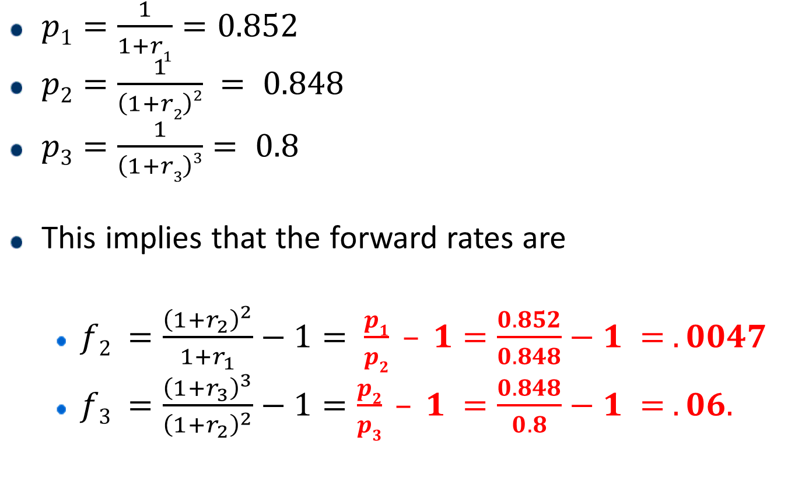
1. The forward rates – from the prices of money:
$p1=\frac{1}{1+r1}=0.852$
$p2=\frac{1}{\left(1+r2\right)2} = 0.848$
$p3=\frac{1}{\left(1+r3\right)3}= 0.8$
This implies that the forward rates are
$f2 =\frac{{\left(1+r_{2}\right)}^{2}}{1+r_{1}}−1= \frac{p1}{p2} – 1=\frac{0.852}{0.848}−1 = .0047$
$f3 =\frac{{\left(1+r_{3}\right)}^{3}}{{\left(1+r_{2}\right)}^{2}}−1=\frac{p2}{p3} – 1 =\frac{0.848}{0.8}−1 = .06.$

Slide 30
2. Uncertainty
Yes, there are theories about the shape of the term structure.
Expectations
Liquidity Preference
Upward bias over expectations

Slide 31
2. Expectations Theory
The observed long-term rate is a function of today’s short-term rate and expected future short-term rates.
Long-term and short-term securities are perfect substitutes.
Forward rates that are calculated from the yield on long-term securities are market consensus expected future short-term rates.

Slide 32
2. Expectations Theory
Under the expectations hypothesis, forward rates are unbiased estimators of future spot rates.
Many otherwise-well-educated people think that this is the definition of a forward rate, but it is not!
Empirically, is this true?
No.
Forward rates seem to be higher than future spot rates on average.
Think of an upward-sloping treasury yield curve for intuition (on board).
This upward slope is the usual case.
Yet interest rates do not seem to rise forever.

Slide 33
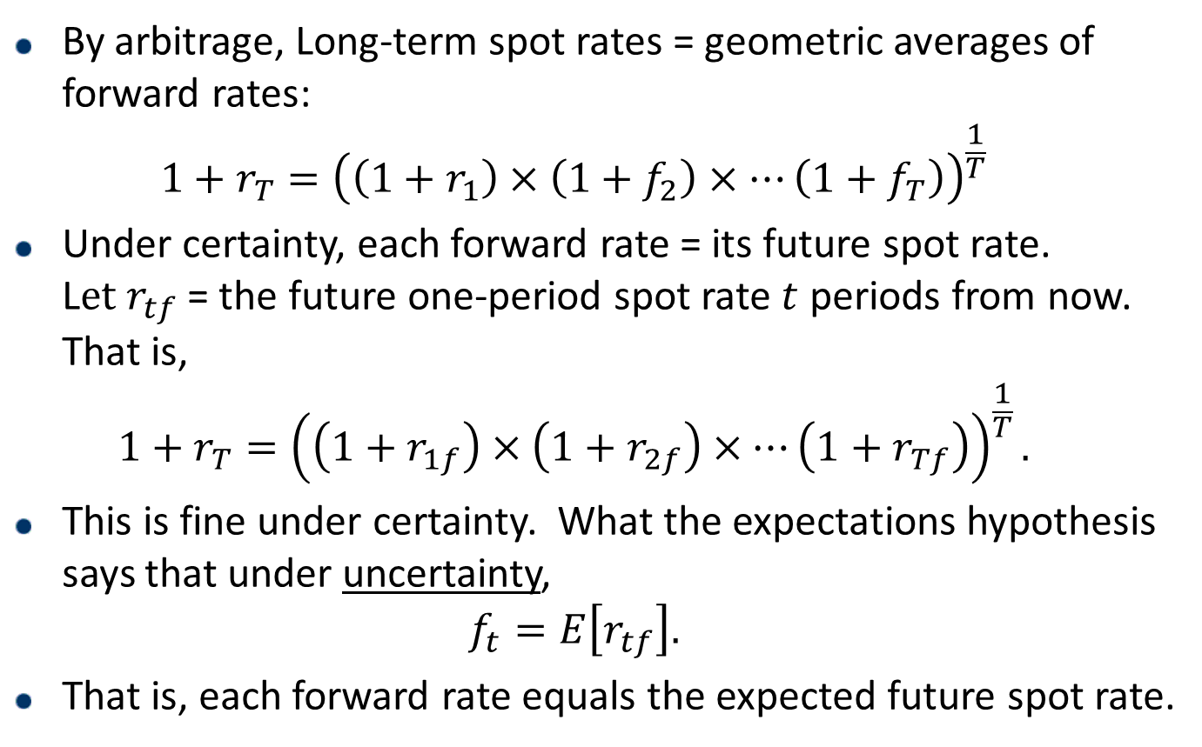
2. Expectations Theory says What?
By arbitrage, Long-term spot rates = geometric averages of forward rates: $1+r_{T}={\left(\left(1+r_{1}\right)×\left(1+f_{2}\right)×…\left(1+f_{T}\right)\right)}^{\frac{1}{T}}$
Under certainty, each forward rate = its future spot rate. L$et r_{tf}$ = the future one-period spot rate $t$ periods from now. That is, $1+r_{T}={\left(\left(1+r_{1f}\right)×\left(1+r_{2f}\right)×…\left(1+r_{Tf}\right)\right)}^{\frac{1}{T}}.$
This is fine under certainty. What the expectations hypothesis says that under uncertainty, $f_{t}=E\left[r_{tf}\right].$
That is, each forward rate equals the expected future spot rate.

Slide 34
2. How to fit the facts
We have already stated that forward rates are higher than future spot rates on average.
What sort of theory generates this result?
One possibility is the liquidity premium theory.

Slide 35
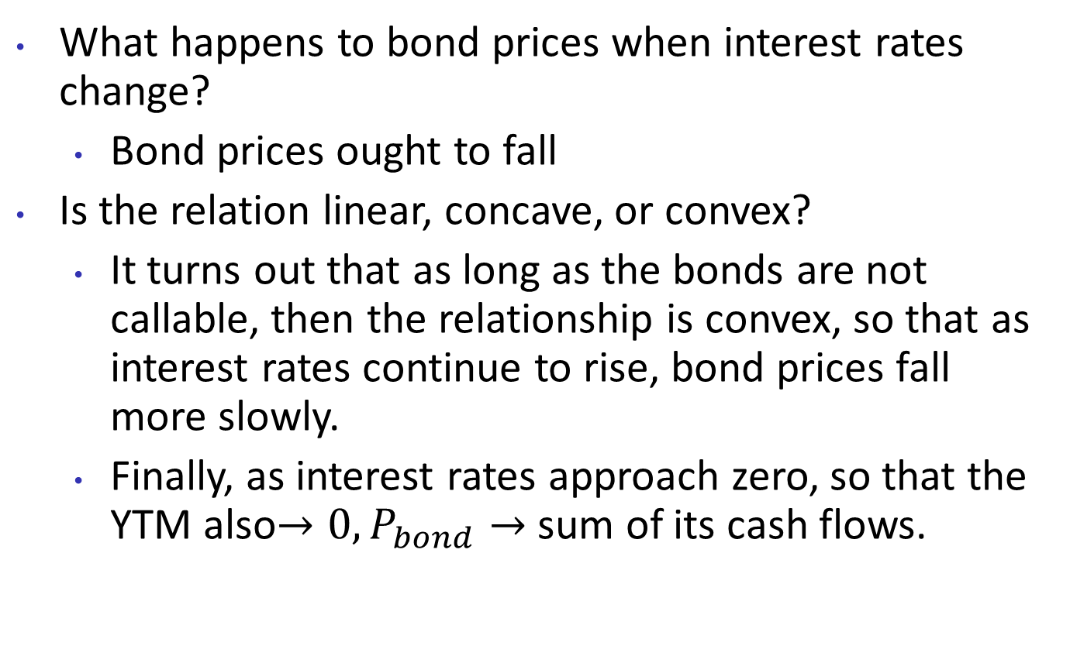
2. Liquidity Premium Theory
Liquidity premium Theory Claim:
“Long-term bonds are more risky”
Thus “Investors demand a premium for the risk associated with long-term bonds.”
Thus “yield curve has an upward bias built into the long-term rates because of the risk premium.”
More risky for whom? What assumption would make this claim make sense?
If long bonds are more risky, forward rates contain a liquidity premium (usually positive)
$f_{N}=E\left(r_{N}\right)+$liquidity premium
Notes:
For long-term investors, short-term debt (rolled over) would be riskier!
Implicit assumption: The bond market is unbalanced. More people want to lend short, borrow long.
If investors read Siegel's book and put long-term capital into equity, this is true!
ALSO note LTD is geo avg of forward rates, thus from the eqn above, LTD has a larger liquidity premium.

Slide 36
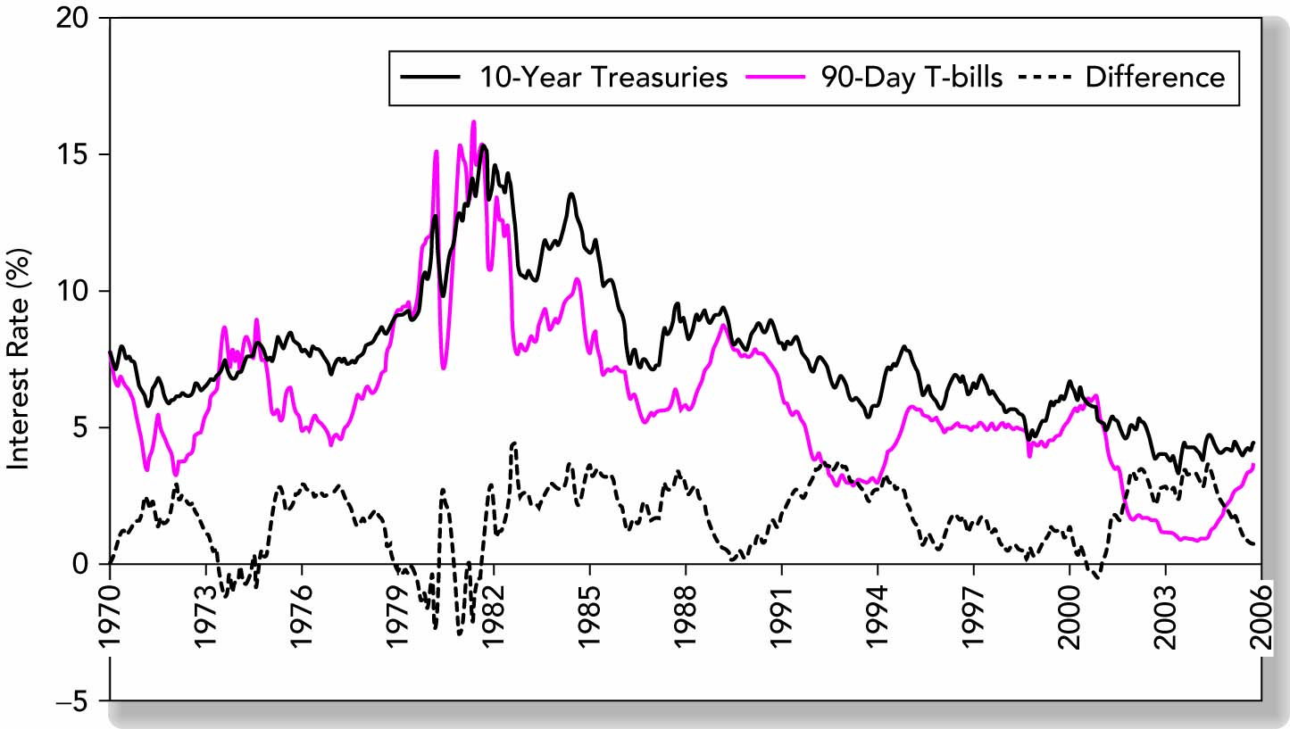
2. The Term Spread – empirical justification for liquidity premium

Slide 37
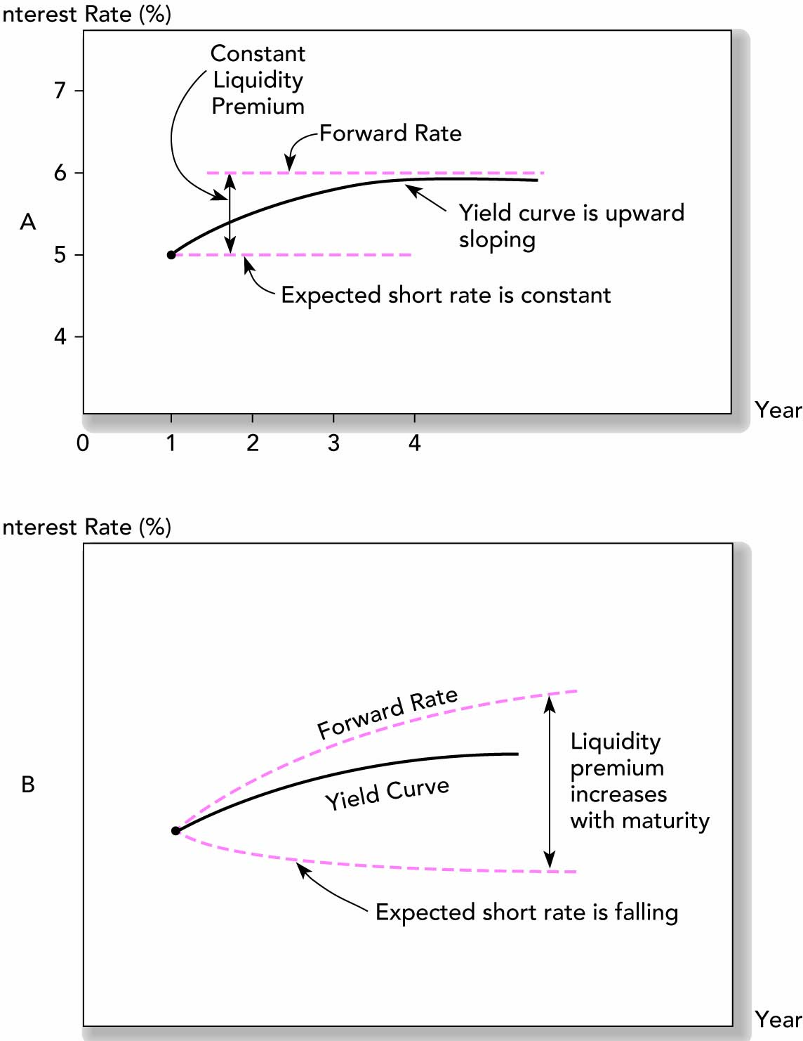
2. Putting it together (Figure 15.4)
Investments fall 2018
Notes:
Constant liquidity premium means forward rate between any two times other than 0 and 1 is constant (1/2 and 1 is not mentioned). This cannot be literally true, of course. Probably it’s more realistic to have the liquidity premium to increase with maturity, perhaps at a decreasing rate. Of course, all these forward rates are equilibrium quantities, and economics places little guidance on the form of the relationship.

Slide 38
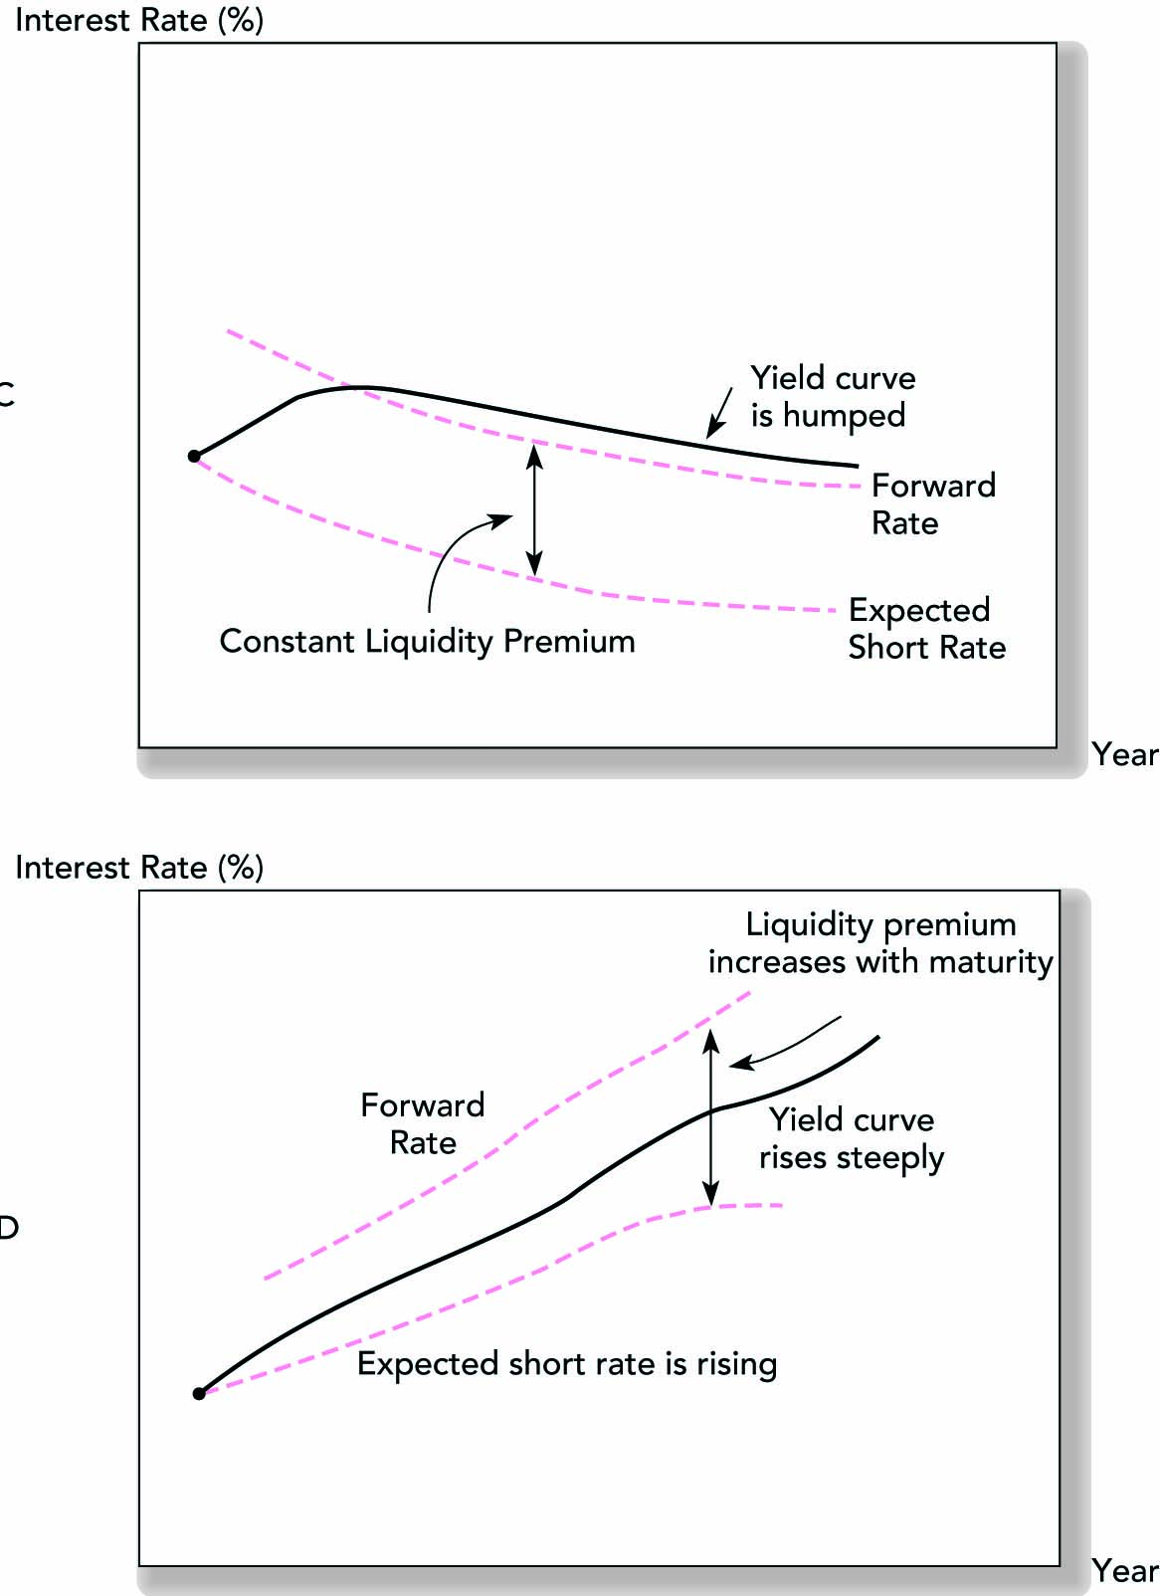
2. Figure 15.4 Yield Curves (Concluded)
Investments fall 2018

Slide 39
That’s it
Next meeting: Managing Bond Portfolios.
Chapter 16 of BKM.

